Slide 1

Browsing and Comparing Genomes Using the Gramene Ensembl Browser
www.gramene.org
Joshua Stein
Cold Spring Harbor Laboratory
Mirror
www.plants.ensembl.org

Slide 2
23 Complete Genomes
Crops
Models
Phylogenetic significance

Slide 3
Annotation & Analysis
 | Community Annotation |  |  | Gramene Annotation & Analysis
Species | Genes | SNP | RNAseq | RepMask | Fgenesh | InterPro | GO | dbXref | EST/cDNA alignment | Genome alignment | Phylogenetic trees
Oryza sativa ssp. japonica | X | X |  | X | X | X | X | X | X | X | X
Oryza sativa ssp. indica | X | X |  | X | X | X | X | X | X | X | X
Oryza glaberrima | X | X | X | X | X | X | X | X | X | X | X
Brachypodium distachyon | X |  |  | X | X | X | X | X | X | X | X
Zea mays | X | X | X | X | X | X | X | X | X | X | X
Sorghum bicolor | X |  |  | X | X | X | X | X | X | X | X
Arabidopsis thaliana | X | X |  | X | X | X | X | X | X | X | X
Arabidopsis lyrata | X |  |  | X | X | X | X | X | X | X | X
Glycine max | X |  |  | X | X | X | X | X | X | X | X
Vitis vinifera | X | X |  | X | X | X | X | X | X | X | X
Populus trichocarpa | X |  |  | X | X | X | X | X | X | X | X
Selaginella moellendorffii | X |  |  | X | X | X | X | X | X | X | X
Physcomitrella patens | X |  |  | X | X | X | X | X | X | X | X
Chlamydomonas reinhardtii | X |  |  | X | X | X | X | X | X | X | X
Cyanidioschyzon merolae | X |  |  | X | X | X | X | X | X | X | X
Oryza brachyantha (FF) 3S |  |  |  | X | X |  |  |  | X | X | X
Oryza officinalis (CC) 3S |  |  |  | X | X |  |  |  | X | X | X
Oryza punctata (BB) 3S |  |  |  | X | X |  |  |  | X | X | X
Oryza minuta (BB) 3S |  |  |  | X | X |  |  |  | X | X | X
Oryza minuta (CC) 3S |  |  |  | X | X |  |  |  | X | X | X
Oryza barthii (AA) 3S |  |  |  | X | X |  |  |  | X | X | X
Oryza nivara (AA) 3S |  |  |  | X | X |  |  |  | X | X | X
Oryza rufipogon (AA) 3S |  |  |  | X | X |  |  |  | X | X | X

Slide 4
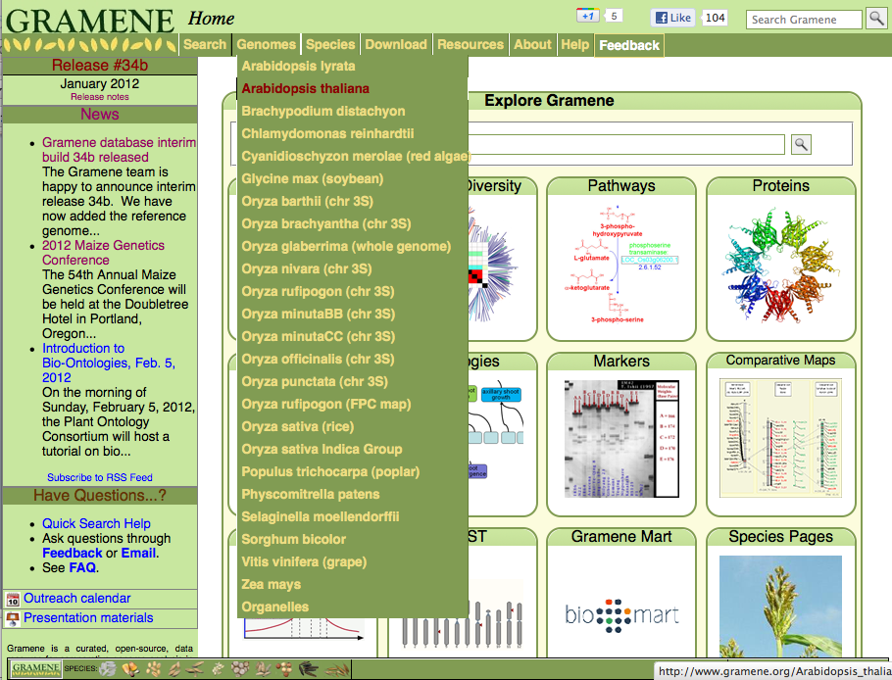
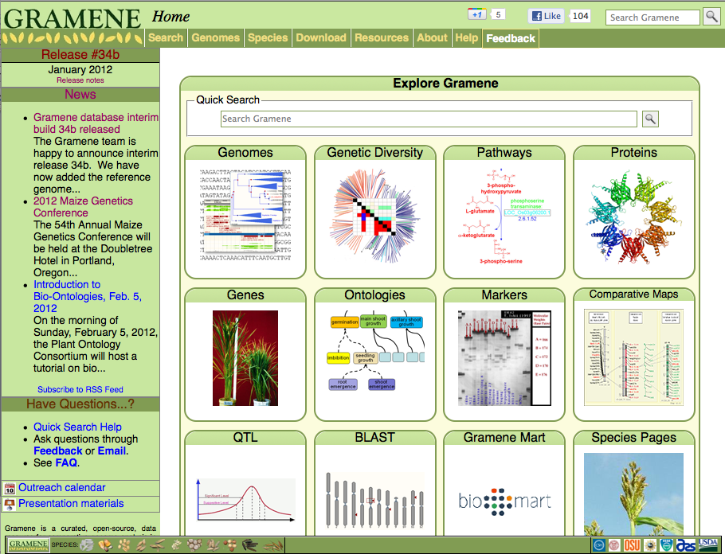

Slide 5
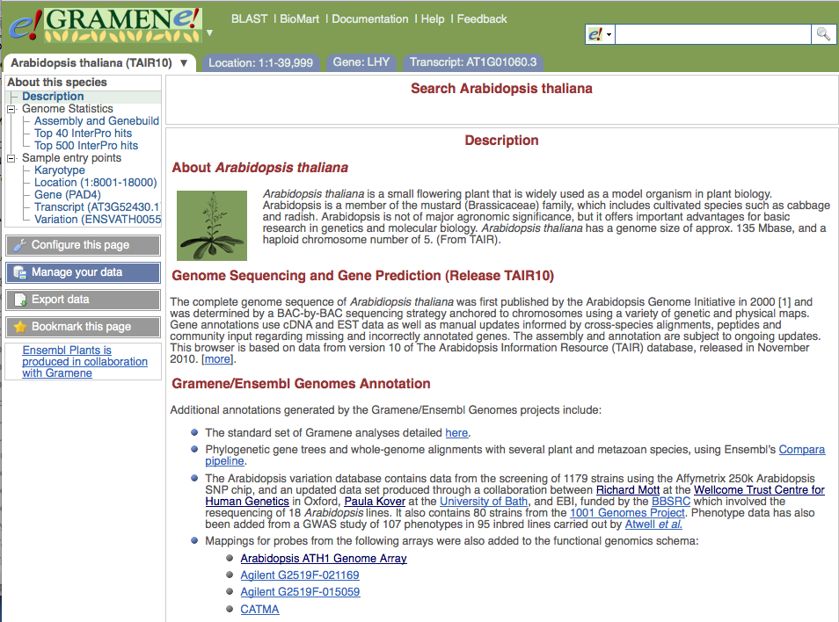
Quick entry points

Slide 6
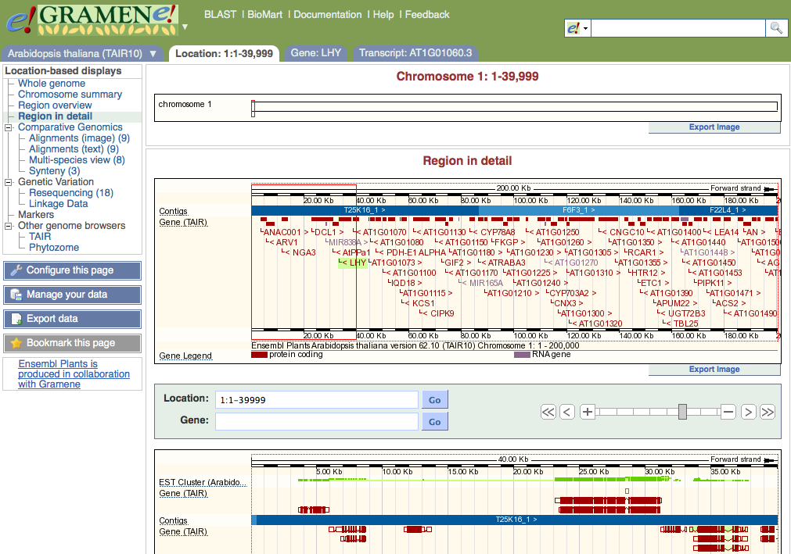
Browser tracks
Whole genome alignments
Synteny views
Location-based variation

Slide 7
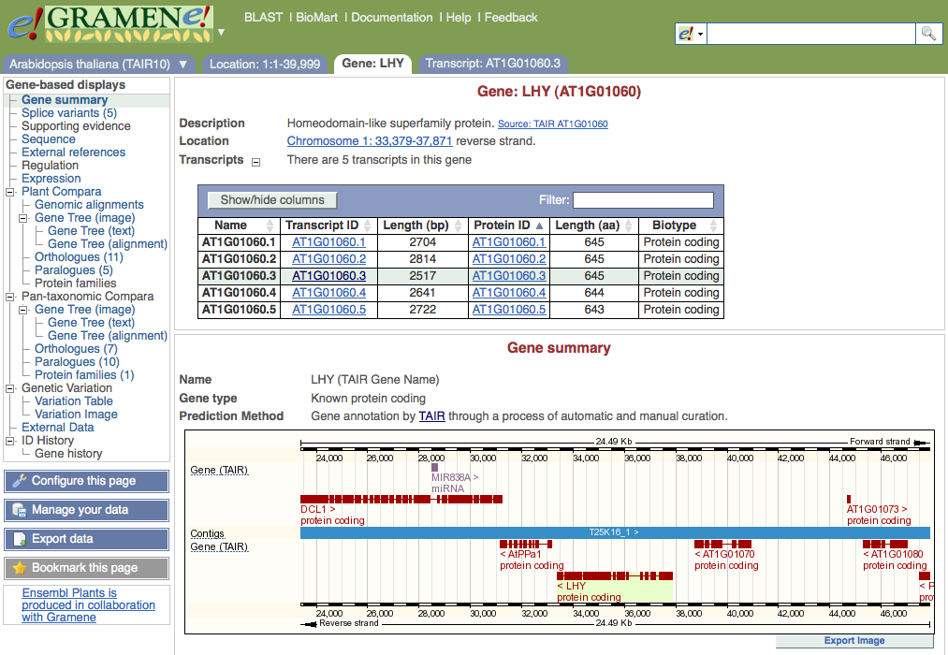
Gene sequence
Splice variants
Gene centered variation
Phylogenetic trees
Cross-reference to external databases

Slide 8
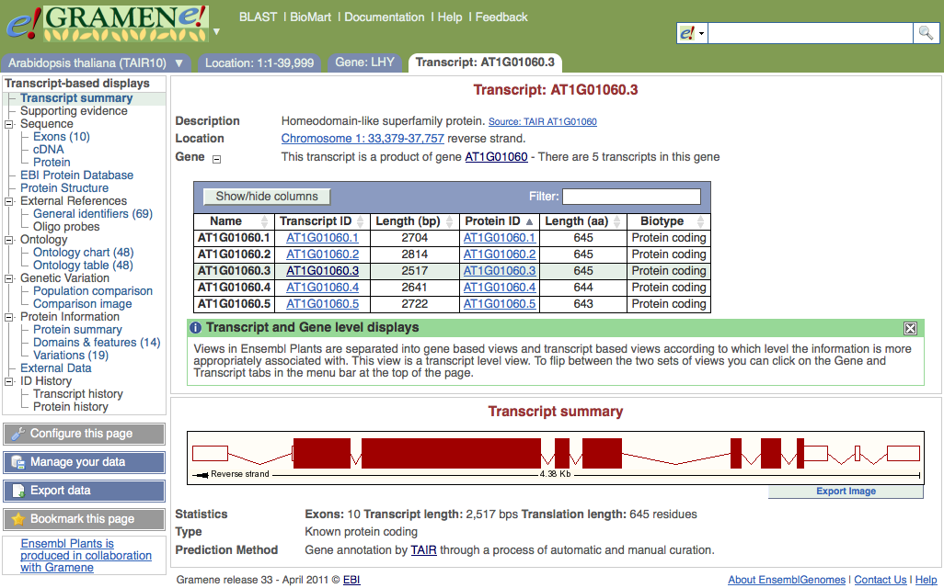
Transcript & protein sequences
Protein structure
Transcript & protein based variation
GO and other ontologies

Slide 9
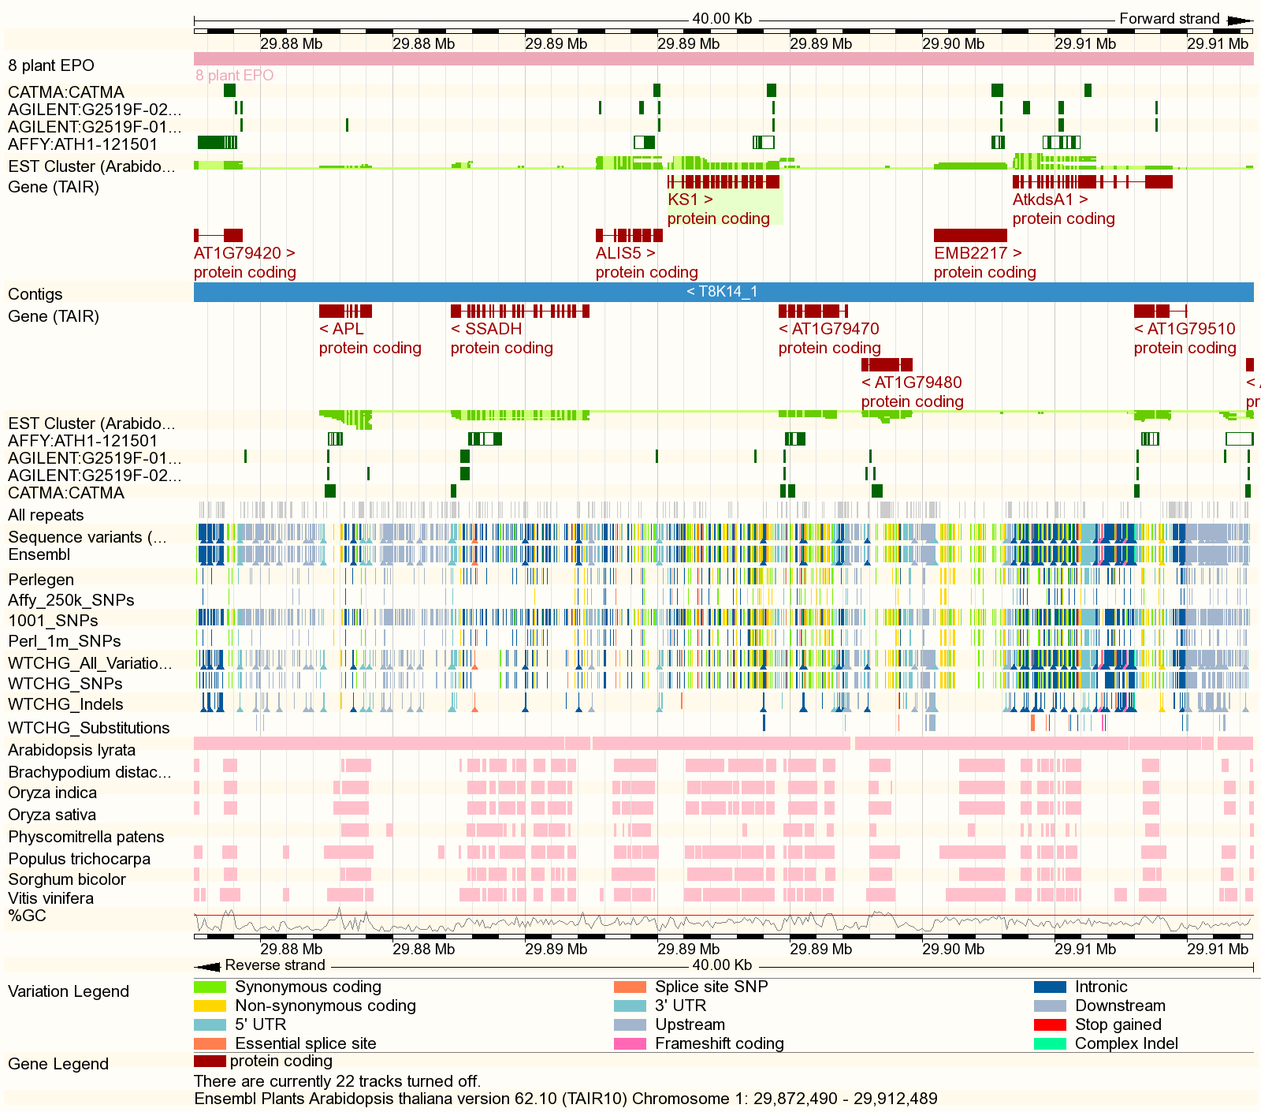
Location View Browser Tracks
TAIR 10 Annotation
EST/cDNA alignments
Array probes
Repeats
Variation
Genome alignments
-cross-species browsing

Slide 10
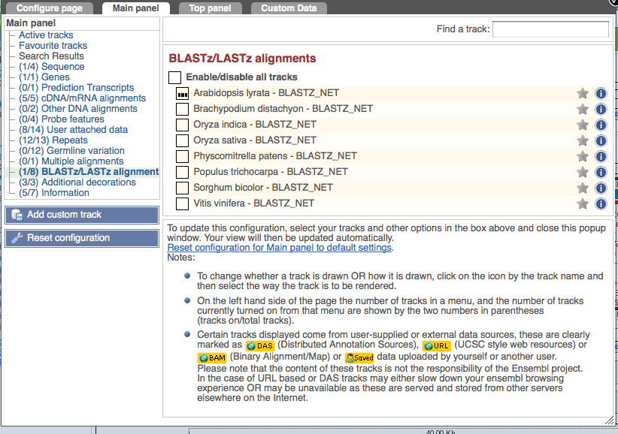
Configuring Tracks

Slide 11
Standard Analysis & Visualization
InterPro domain & GO functional annotation
Cross-reference to external ID’s
Whole Genome Alignment (Blastz-chain-net)
Phylogenetic Gene Trees (Compara)
Synteny Analysis
Consequences of SNP

Slide 12
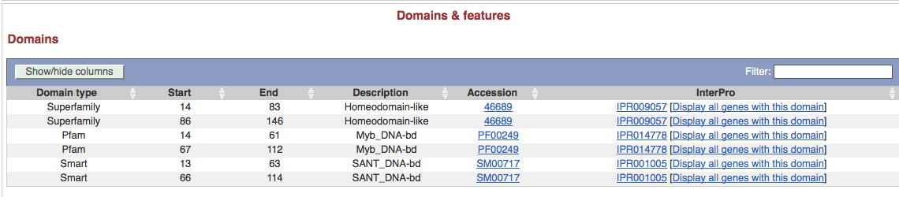
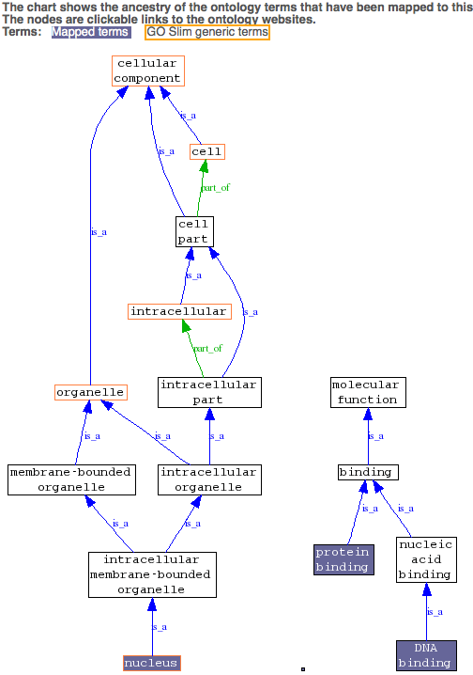
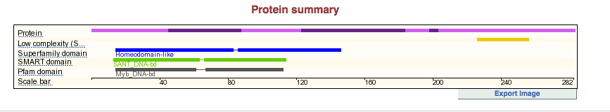
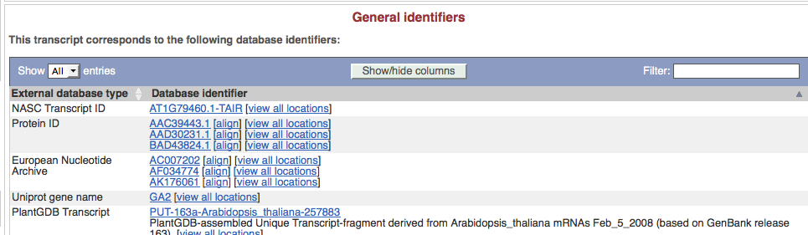
InterPro/dbXref/GO
Structural prediction: Pfam, PIRSF, PRINTS, PROSITE, SMART, SUPERFAMILY, TIGRFAM, TMHMM, SignalP
Cross-reference genes to 3rd party identifiers: Entrez Gene, PlantGDB, PUTs, RefSeq, Gene Index, UniGene, UniProtKb/Swissprot, NASC, IPI, WikiGene
Gene Ontology, Plant Ontology

Slide 13
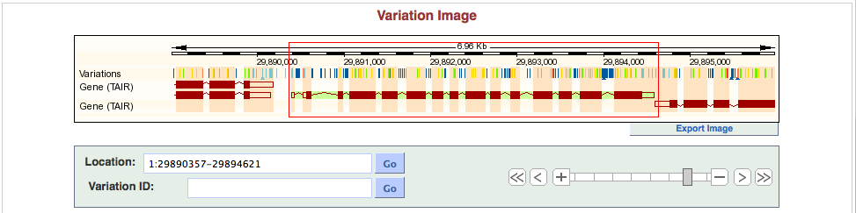
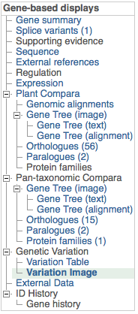
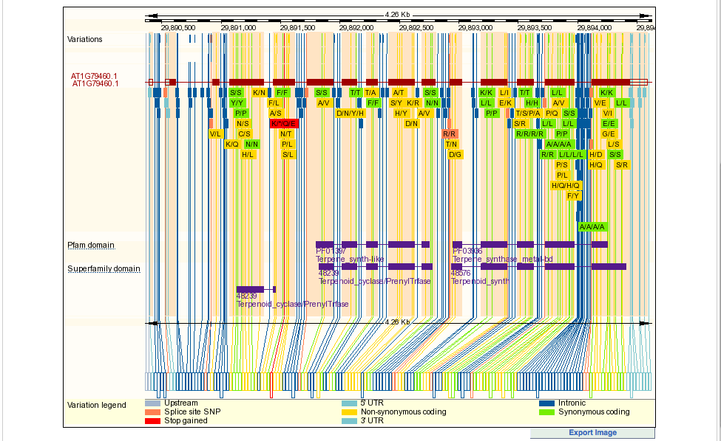
Gene Variation Image
Shows functional consequence relative to gene and protein domain structure

Slide 14
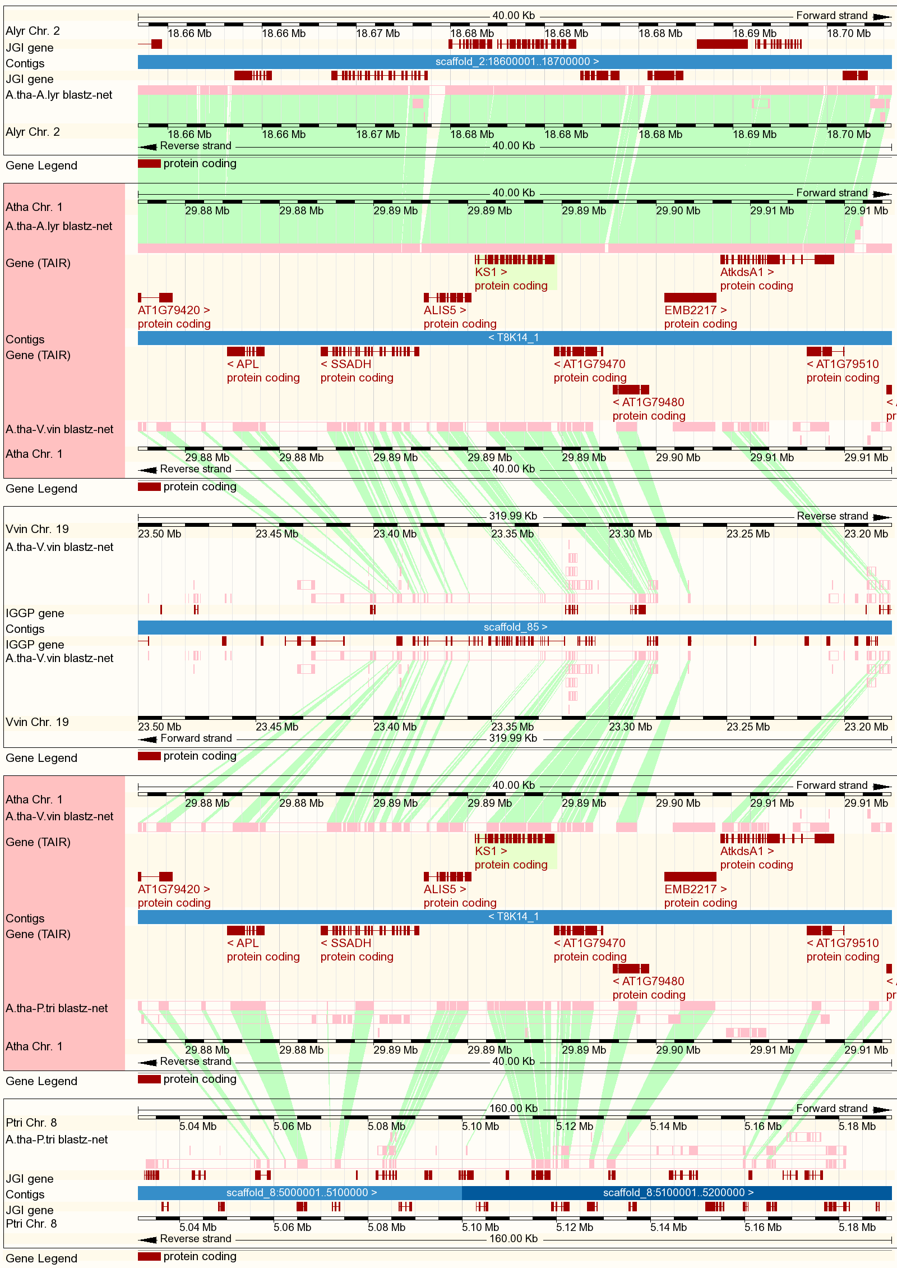
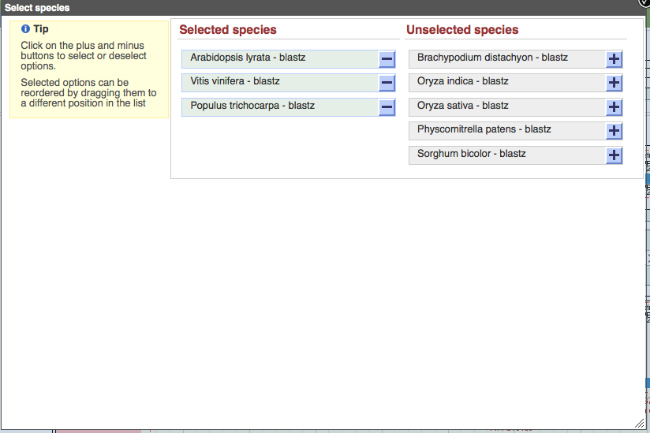
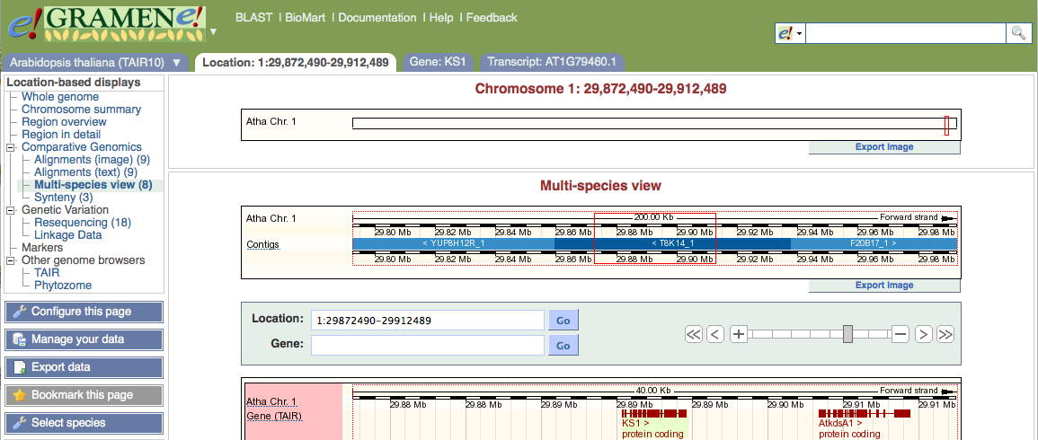
Multi-species View
A. lyrata
Arabidopsis
Grapevine
Arabidopsis
Poplar

Slide 15
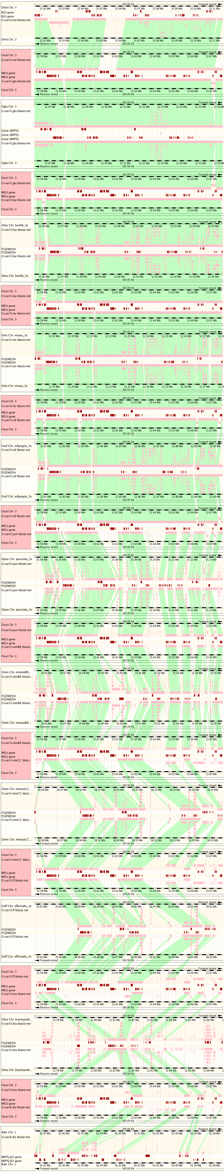
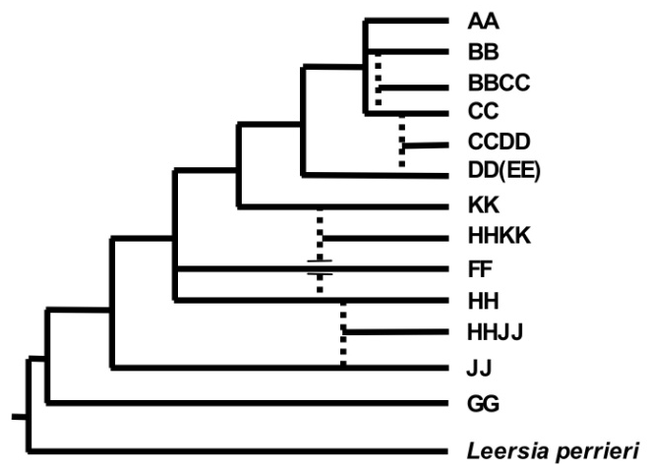
indica
Oryza genus view
O. sativa
O. glaberrima (AA)
O. sativa
O. barthii (AA)
O. sativa
O. nivara (AA)
O. sativa
O. rufipogon (AA)
O. sativa
O. punctata (BB)
O. sativa
O. minuta (BB)
O. sativa
O. minuta (CC)
O. sativa
O. officinalis (CC)
O. sativa
O. brachyantha (FF)
O. sativa
Brachypodium distachyon

Slide 16
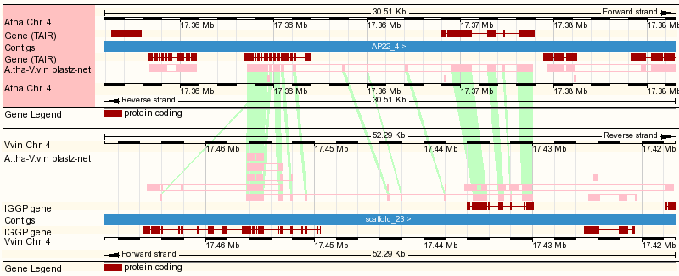
Conserved non-coding regions
Notes:
http://www.gramene.org/Arabidopsis_thaliana/Location/Multi?db=core;r=4:17350953-17381463;r1=4:17416971-17469263:-1;s1=Vitis_vinifera

Slide 17
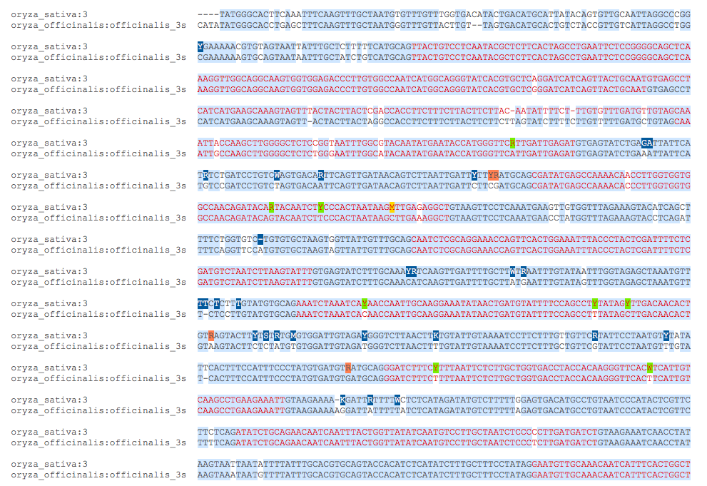
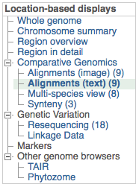
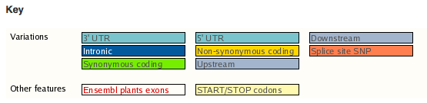
View Sequence Alignment

Slide 18
Phylogenetic Analysis Tools

Slide 19
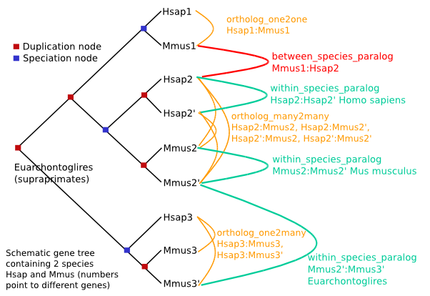
Compara Gene Trees
Reconstructing evolutionary histories
Gene Trees for 15 plants plus human, Ciona, fly, worm, & yeast
Infers orthologs and paralogs by reconciling gene tree with input species tree
Taxonomic dating
Oryza centered gene trees
3 complete reference for rice
7 chr 3S arm Oryza species
Brachypodium, sorghum, Arabidopsis
http://useast.ensembl.org/info/docs/compara/homology_method.html
Vilella A.J., et al. (2008). Genome Res. Pre-print: doi:10.1101/gr.073585.107

Slide 20
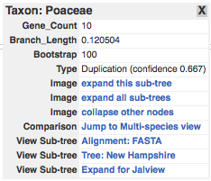
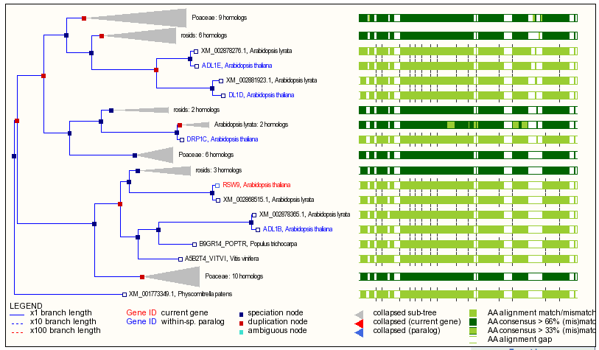
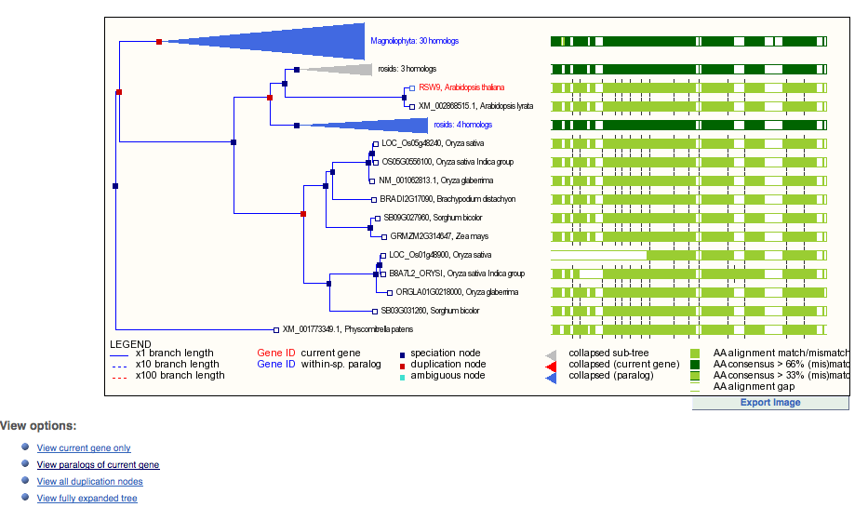
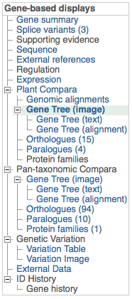
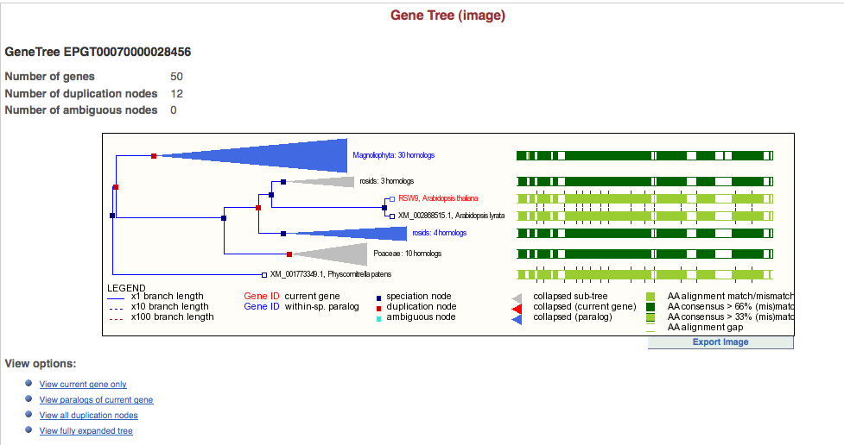
Tree Viewer
Speciation node = ortholog
Duplication node = paralog

Slide 21
Newick Tree & Alignment
(((ENSCINP00000002474_Cint_:0.0000,
R10D12.12_Cele_:3.4477):0.7716,
FBpp0084782_Dmel_:0.8566):0.0000,
(((((BRADI3G43170.1_Bdis_:0.0615,
BRADI2G38000.1_Bdis_:0.1536):0.0214,
((LOC_Os02g26814.1_Osat_:0.0000,
BGIOSGA008178-PA_Oind_:0.0000):0.0000,
ORGLA02G0140900.1_Ogla_:0.0000):0.0938):0.0231,
(((GRMZM2G050705_P02_Zmay_:0.0099,
GRMZM2G124671_P01_Zmay_:0.0745):0.0043,
Sb08g016480.1_Sbic_:0.0348):0.0000,
(GRMZM2G022470_P01_Zmay_:0.0475,
Sb04g017490.1_Sbic_:0.1037):0.0000):0.0917):0.1118,
(((POPTR_0005s03870.1_Ptri_:0.0420,
POPTR_0013s02650.1_Ptri_:0.0427):0.0918,
(GSVIVT01006266001_Vvin_:0.0342,
GSVIVT01000019001_Vvin_:0.0817):0.1210):0.0363,
((scaffold_702792.1_Alyr_:0.0043,
scaffold_603852.1_Alyr_:0.0632):0.0277,
AT4G16710.1_Atha_:0.0204):0.2813):0.1261):0.5081,
E_GW1.232.43.1_Ppat_:0.3698):0.3605):0.0000;
ORGLA02G0140900.1_Ogla_ VFVTVGTTCF DALVKAVDSP QVKEALLEKG YTDLIIQMGR GTY-------
BRADI2G38000.1_Bdis_ VFVTVGTTCF DALVKAVDSE EVKQALLRKG YTDLLIQMGR GTY-------
GRMZM2G050705_P02_Zmay_ VFVTVGTTCF DALVMAVDSP EVKKALLQKG YSNLLIQMGR GTY-------
POPTR_0005s03870.1_Ptri_ VFVTVGTTLF DALVRTVDTK EVKQELLRNG YTHLIIQMGR GSY-------
GRMZM2G022470_P01_Zmay_ VFVTVGTTCF DALVMAVDSP EVKKTLLQKG YSNLLIQMGR GTY-------
BRADI3G43170.1_Bdis_ VFVTVGTTCF DALVKKVDSP QVKEALWQKG YTDLFIQMGR GTY-------
GSVIVT01006266001_Vvin_ VFVTVGTTCF DALVKAVDTQ EFKKELSARG YTHLLIQMGR GSY-------
Sb08g016480.1_Sbic_ ---------- ----MAVDSP EVKMALLQKG YSNLLIQMGR GTY-------
GRMZM2G124671_P01_Zmay_ VFVTVGTTCF DALVMAVDSP EVKKALLQKG YSNLLIQMGR GTY-------
Sb04g017490.1_Sbic_ ---------- ----MAVASP EVKKALLQKG YSNLVIQMGR GTY-------
BGIOSGA008178-PA_Oind_ ---------- ---------- ---------- ---------- ----------
E_GW1.232.43.1_Ppat_ VLVTVGTTLF DALVREASSQ PCRQVLADFG YSSLVIQRGK GSF-------
scaffold_702792.1_Alyr_ VFVTVGTTSF DALVKAVVSE DVKDELQKRG FTHLLIQMGR GIF-------
R10D12.12_Cele_ ---------- ---------- ---------- ---------- ---NQDVIDR
ENSCINP00000002474_Cint_ IFVTVGTTSF DELTETITSK PVQKVLQSQG YDKVTIQYGR GKH-------
scaffold_603852.1_Alyr_ VFVTVGTTSF DALVKAVVSE DVKDELQKRG FTHLLIQMGR GNF-------
AT4G16710.1_Atha_ VFVTVGTTSF DALVKAVVSQ NVKDELQKRG FTHLLIQMGR GIF-------
LOC_Os02g26814.1_Osat_ VFVTVGTTCF DALVKAVDSP QVKEALLEKG YTDLIIQMGR GTY-------
GSVIVT01000019001_Vvin_ VFVTVGTTCF DALVKAVDTH EFKRELFARG YTHLLIQMGR GSY-------
FBpp0084782_Dmel_ VYITVGTTKF DALISTASTE PALKALQNRK CTKLVIQHGN SQP-------
POPTR_0013s02650.1_Ptri_ VFVTVGTTLF DALVRTVDTK EVKQELLRKG YTDLVIQMGR GSY-------

Slide 22
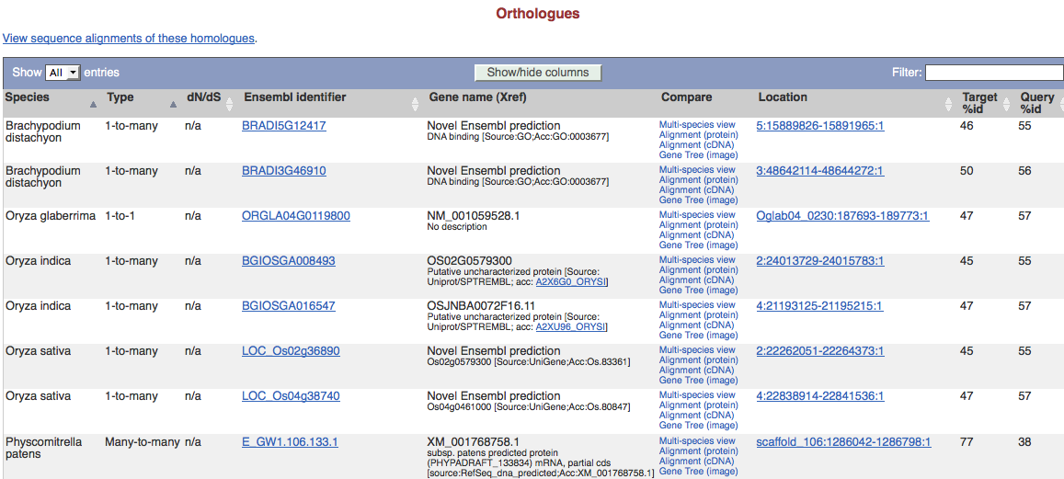
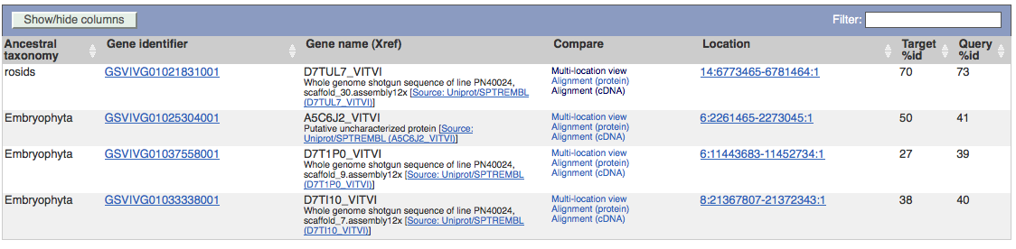
Orthologs & Paralogs

Slide 23
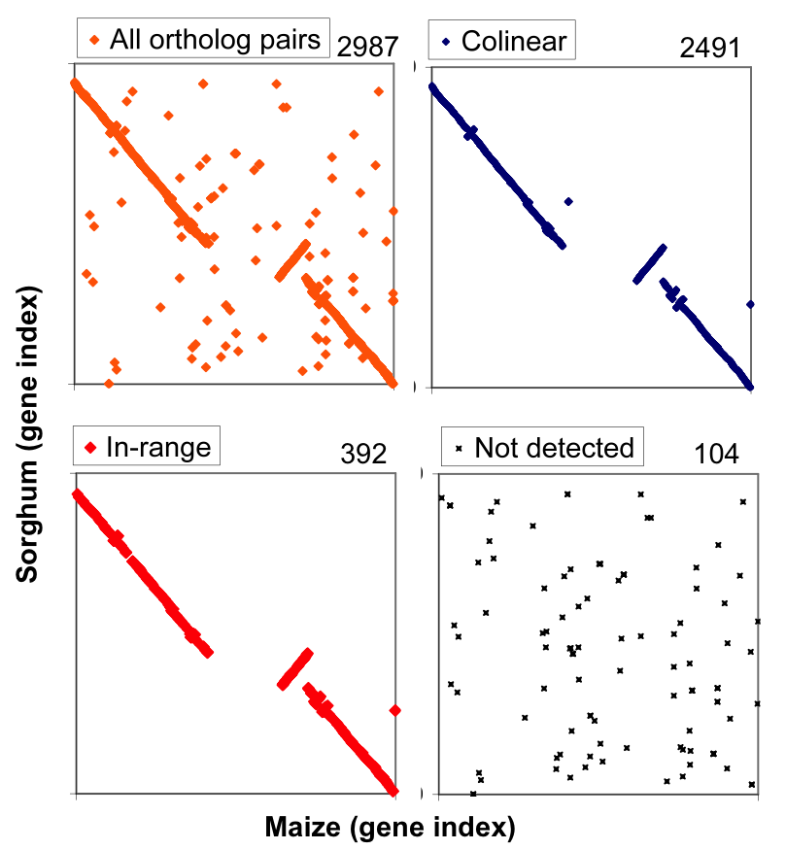
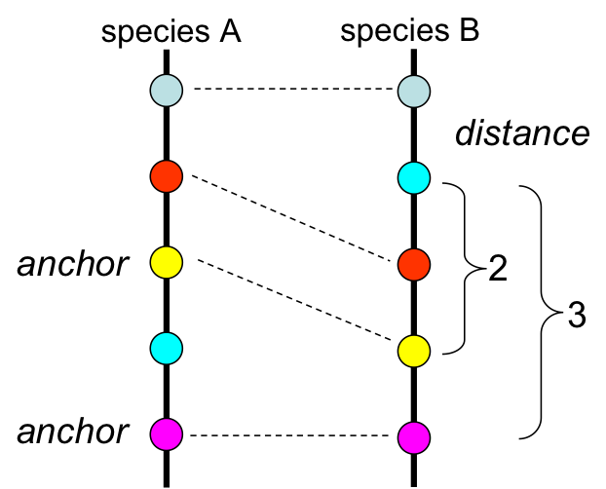
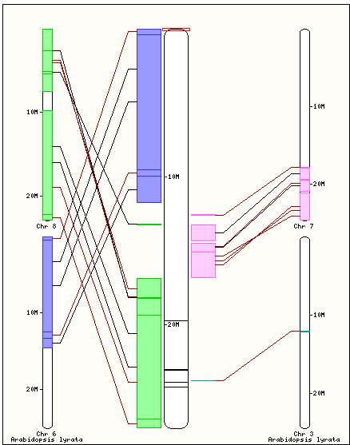
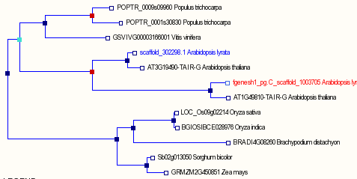
Gene-Centered Synteny Build
Compara Orthologs
Collinear mappings (DAGchainer)
“in-range” mappings near collinear anchors
Map
Oryza sativa Japonica | O.jap
Brachypodium distachyon | YES | B.dis
Sorghum bicolor | YES | YES | S.bic
Zea mays | YES | - | YES | Z.mays
Arabidopsis thaliana | - | - | - | - | A.tha
Arabidopsis lyrata | - | - | - | - | YES | A.lyr
Vitis vinifera | - | - | - | - | YES | YES | V.vin
Poplar trichocarpa | - | - | - | - | YES | YES | YES | P.tri
Notes:
http://www.gramene.org/Arabidopsis_lyrata/Gene/Compara_Tree?collapse=;db=core;g=fgenesh1_pg.C_scaffold_1003705;r=1:25911262-25913616;t=fgenesh1_pg.C_scaffold_1003705

Slide 24
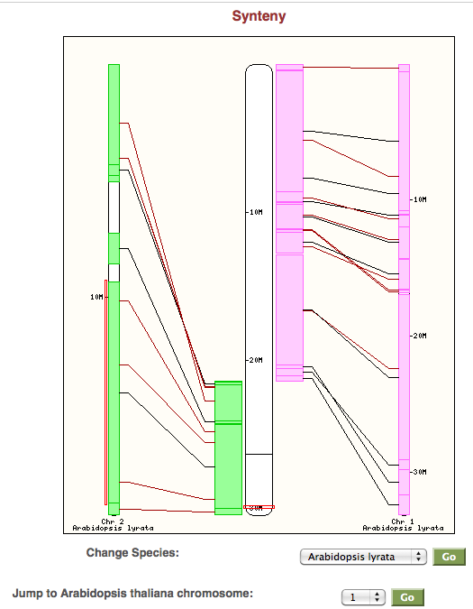
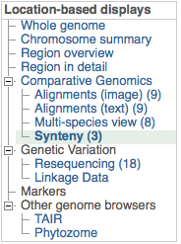
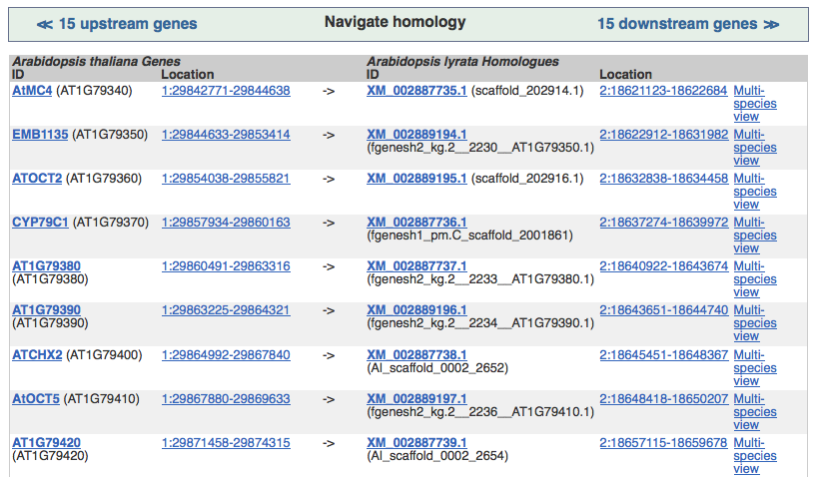
Synteny View
Arabidopsis vs A. lyrata, Navigate to other genome
Ortholog browser
Link to multi-species view

Slide 25
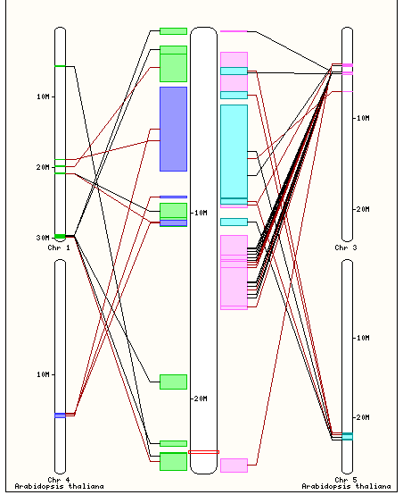
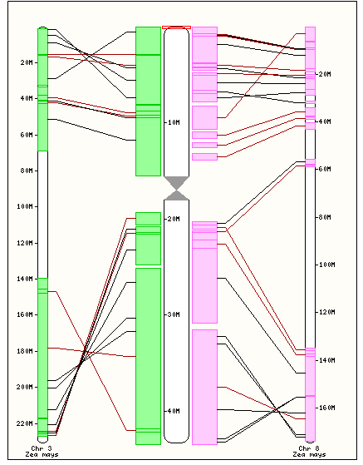
Browse across duplicated regions from polyploidy
Grape reference to map Arabidopsis duplication
Rice reference to map Maize duplication

Slide 26
Some Applications …

Slide 27
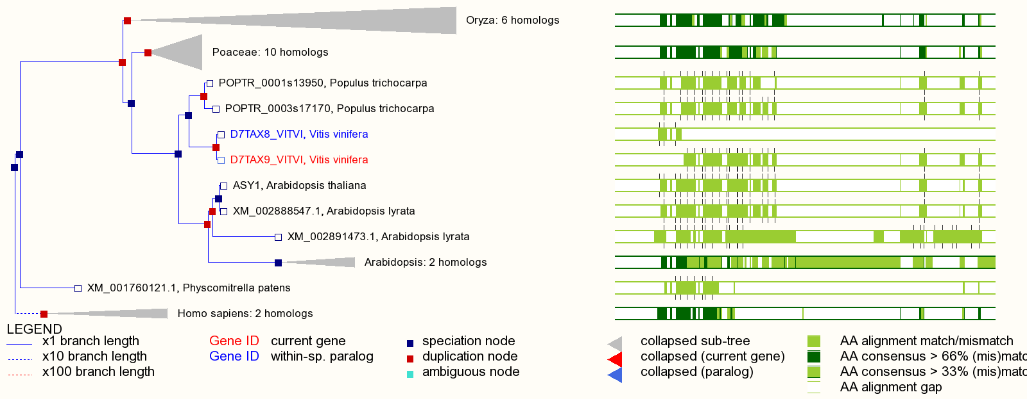
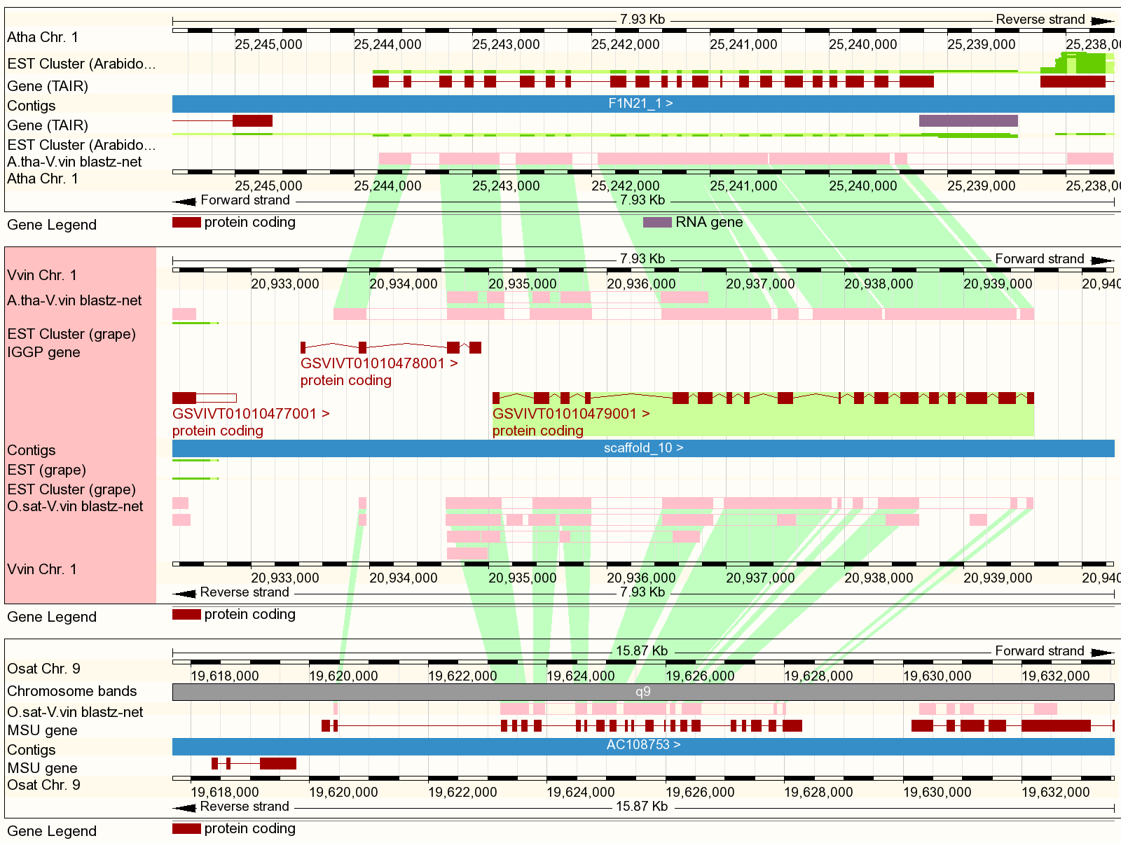
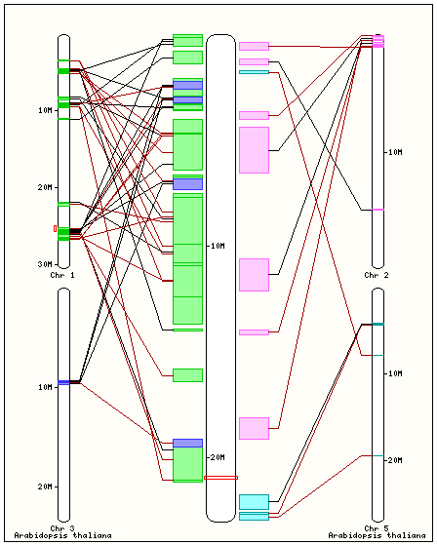
Enrich Annotations in Other Species
Putative mis-annotated Grape gene
Arabidopsis and Rice orthologs both show one gene
Arabidopsis ortholog in correct syntenic context
ftp://ftp.gramene.org/pub/gramene/CURRENT_RELEASE/data/split_genes/
Notes:
http://www.gramene.org/Vitis_vinifera/Gene/Compara_Tree?collapse=498431%2C498476%2C498372%2C498447;db=core;g=GSVIVG01010479001;r=1:20924815-20949814;t=GSVIVT01010479001

Slide 28
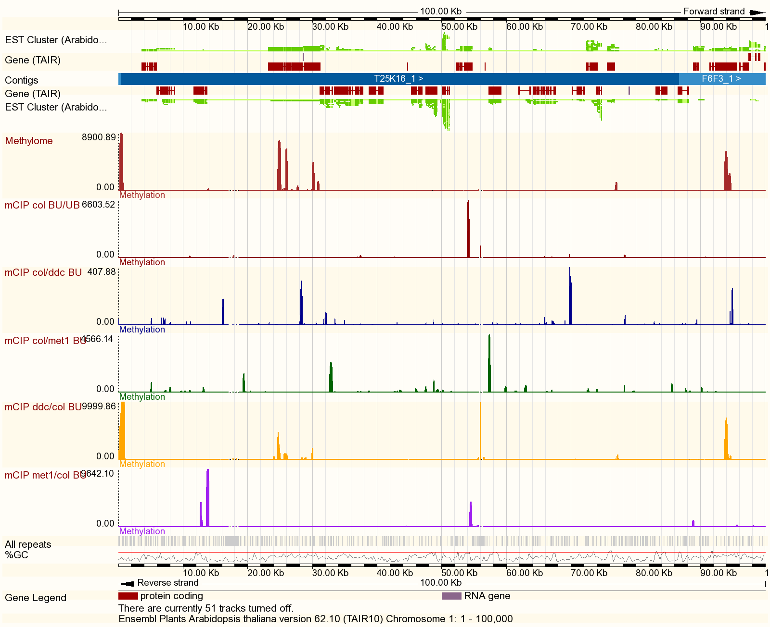
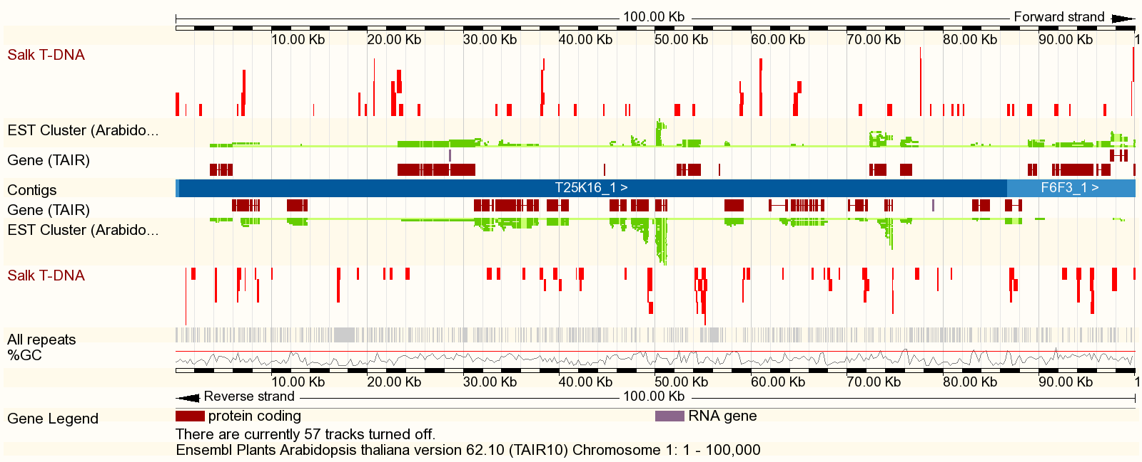
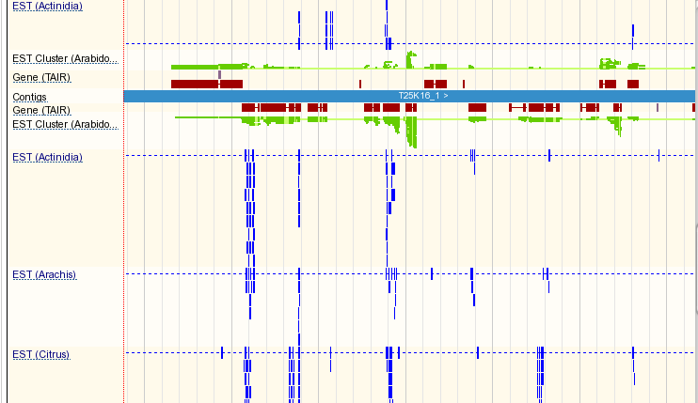
Add Custom Tracks
Methylome (Ecker)
Uploaded from an URL
BED file format
Salk T-DNA lines
Uploaded from my laptop
GFF file format
EST alignments from non-model plants
DAS: Distributed Annotation system
Protocol for sharing 3rd party data
DAS Registry

Slide 29

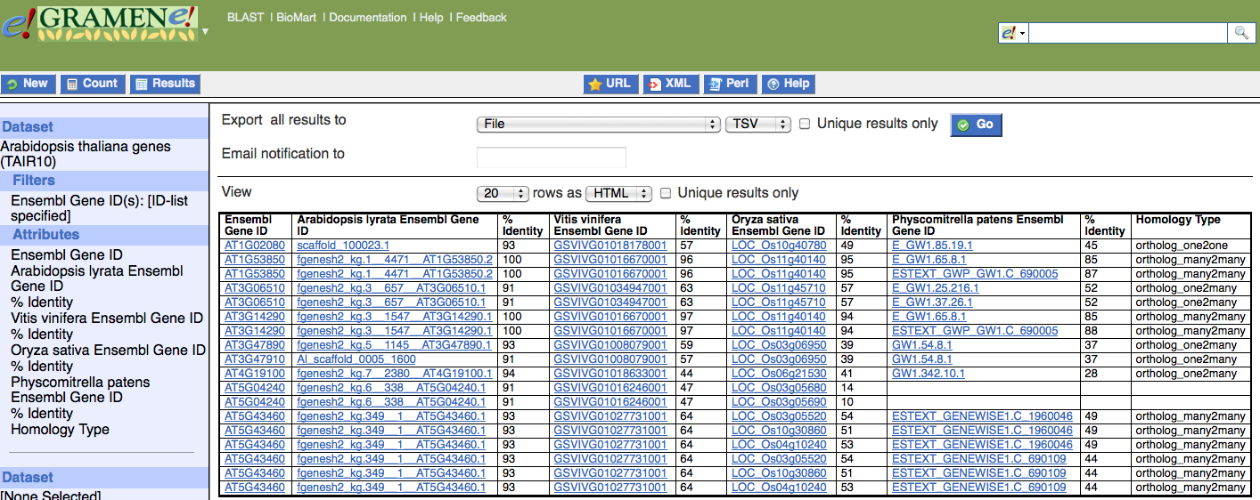
GrameneMart
Custom queries for bulk downloads
Powerful tool for data mining
Orthologs in lyrata, grape, poplar, rice, Brachypodium, sorghum maize, & moss

Slide 30
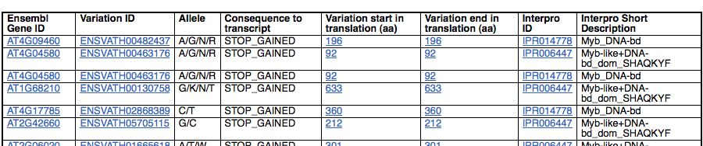
GrameneMart
Custom queries for bulk downloads
Powerful tool for data mining
Use case:
Mine germplasm for loss of function alleles in diversity populations:
All Myb-domain genes with “STOP_GAINED” SNP allele

Slide 31
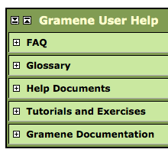


HELP!

Slide 32

Contact Us!

Slide 33



Slide 34


Slide 35


Slide 36


Slide 37


